Slide 1
3TL Tracker
 | YEAR_MONTH
HCO_CODE | Click into for all trackers
3TL New Statuses
Folder Viewer
Drill-down of Folders, current and up-to-date of any FTP files. Current view of HCO.
Mini Trackers
Most recent updates on all 3 tracker’s most recent statuses: -File Submission -DQR -RDD (Either a progress bar, or 3 status cubes)
Correspondence
A more detailed look at the month’s communication and other updates

Slide 2
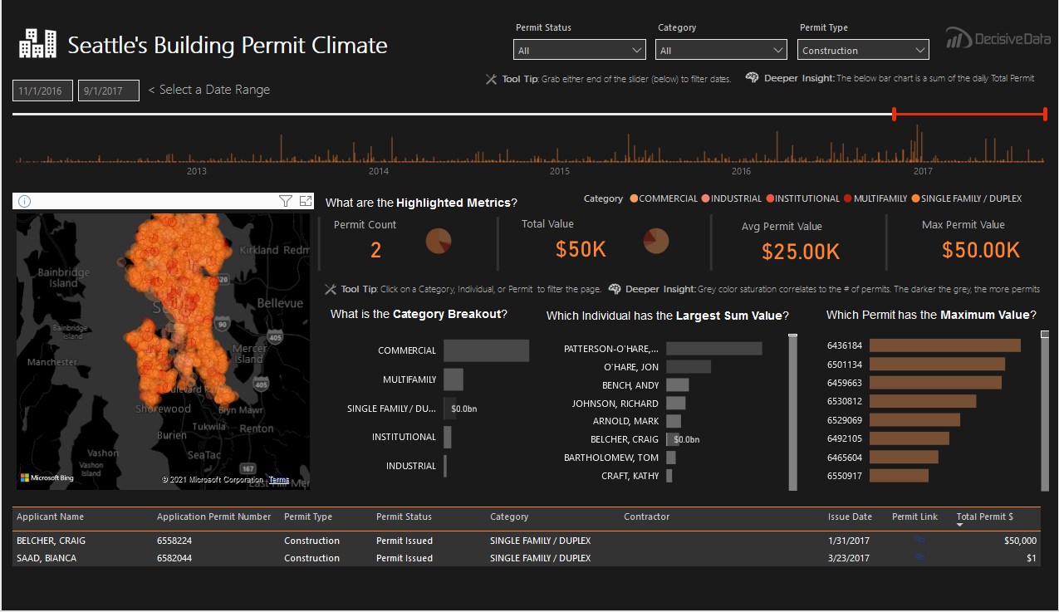

Slide 3
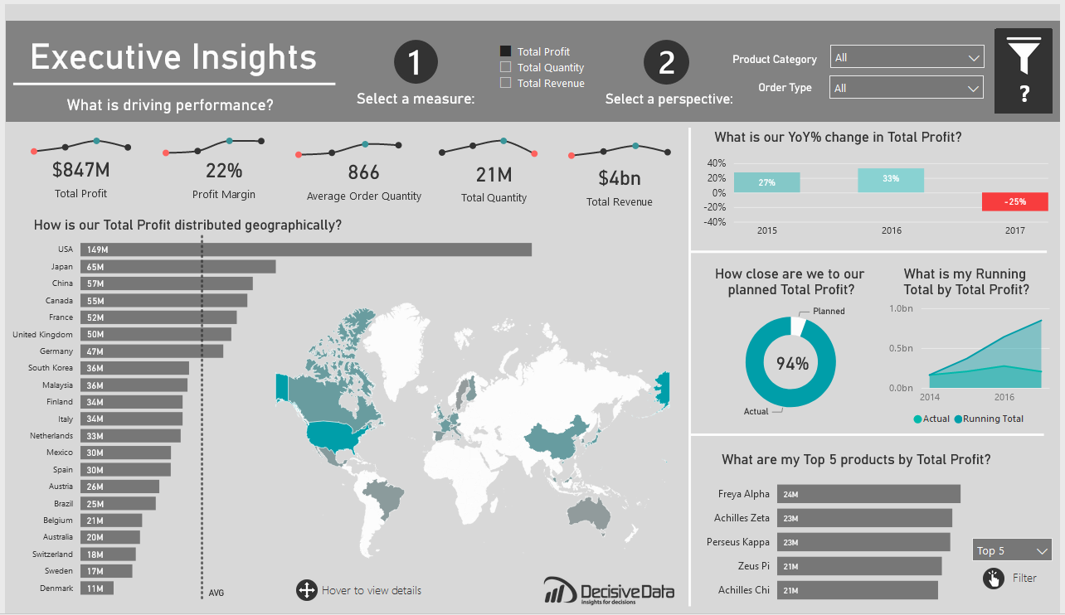

Slide 4
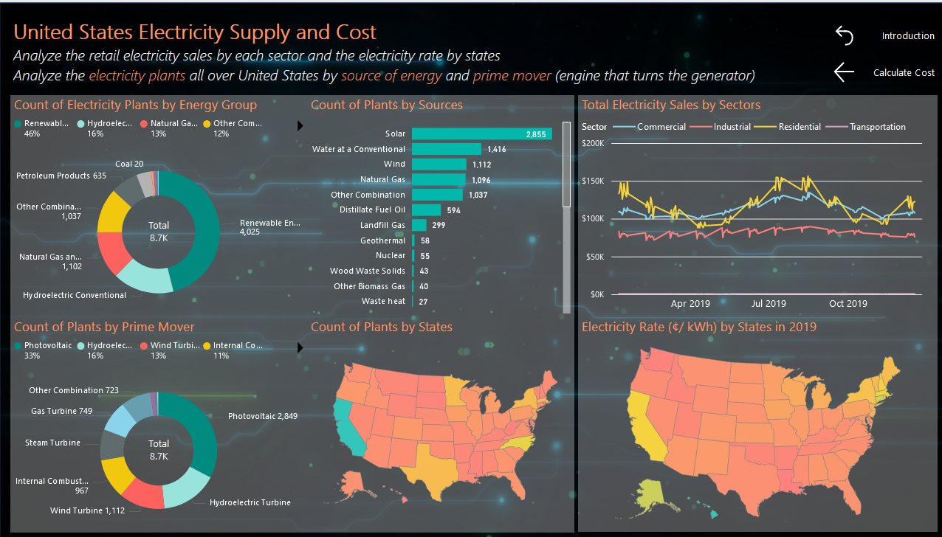

Slide 5
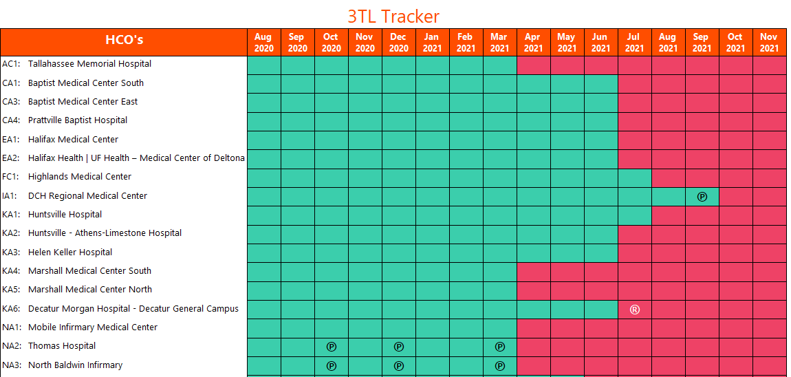
Tool Tip with HCO Name + Status
3TL Tracker
NA2 10/2020
℗
NA2 11/2020
NA2 04/2021
®
NA2 05/2021

Slide 6

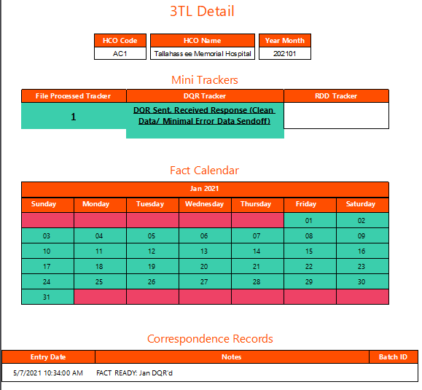
3TL Detail
AC1 – Tallahassee Memorial Hospital - 202101
File Processed Tracker
DQR Tracker
RDD Tracker
1
DQR Sent, Received Response (Clean Data/ Minimal Error Data Sendoff)
0
Fact Calendar
Jan 2021
SU | M | T | W | TH | F | SA
 |  |  |  |  | 01 | 02
03 | 04 | 05 | 06 | 07 | 08 | 09
10 | 11 | 12 | 13 | 14 | 15 | 16
17 | 18 | 19 | 20 | 21 | 22 | 23
24 | 25 | 26 | 27 | 28 | 29 | 30
31
Entry Date | Notes | Batch ID
5/7/2021 10:34:00 AM | FACT READY: JAN DQR”d | 99999
5/7/2021 10:34:00 AM | FACT READY: JAN DQR”d | 99999
5/7/2021 10:34:00 AM | FACT READY: JAN DQR”d | 99999
5/7/2021 10:34:00 AM | FACT READY: JAN DQR”d | 99999
5/7/2021 10:34:00 AM | FACT READY: JAN DQR”d | 99999

Slide 7
Tool Tip with HCO Name + Status
3TL Tracker
NA2 10/2020
℗
NA2 11/2020
NA2 04/2021
®
NA2 05/2021
Click into 3TL, opens window within same page
3TL Detail
Transparent Screen to click out of on the side
AC1 – Tallahassee Memorial Hospital - 202101
File Processed Tracker
DQR Tracker
RDD Tracker
3TL Tracker
NA2 10/2020
℗
NA2 11/2020
NA2 04/2021
®
NA2 05/2021
1
DQR Sent, Received Response (Clean Data/ Minimal Error Data Sendoff)
0
Fact Calendar
Jan 2021
SU | M | T | W | TH | F | SA
 |  |  |  |  | 01 | 02
03 | 04 | 05 | 06 | 07 | 08 | 09
10 | 11 | 12 | 13 | 14 | 15 | 16
17 | 18 | 19 | 20 | 21 | 22 | 23
24 | 25 | 26 | 27 | 28 | 29 | 30
31
Entry Date | Notes | Batch ID
5/7/2021 10:34:00 AM | FACT READY: JAN DQR”d | 99999
5/7/2021 10:34:00 AM | FACT READY: JAN DQR”d | 99999
5/7/2021 10:34:00 AM | FACT READY: JAN DQR”d | 99999
5/7/2021 10:34:00 AM | FACT READY: JAN DQR”d | 99999
5/7/2021 10:34:00 AM | FACT READY: JAN DQR”d | 99999

Slide 8

DQR Tracker
NA2 11/2020
NA2 04/2021
KA2 10/2020
℗
KA2 11/2020
KA2 04/2021
KA2 05/2021
KA2 04/2021
KA2 06/2021
No DQR Sent
No DQR Sent (Bad Data/ No Data)
DQR Sent, No Response
DQR Sent, Received Response (Error Data Cleanup)
DQR Sent, Received Response (Clean Data/ Minimal Error Data Sendoff)
DQR Ready, Not Sent
Is this Status needed anymore?

Slide 9
Manual Process: Jemel
Manual Process: Keith
Manual Process: Jemel
Member Communication Received
3T/PR files are received by member. Can include resubmissions at any time.
FTP File Integrity Check
Review files for integrity issues, files size issues, missing data, etc. 3TL Assist used in this process.
3T/PR Load into Staging Tables
DQR Generated
DQR retrieved from 3TL Assist.
Correspondence w/ Member
DQR send out, communicate with member on error threshold or any changes to load.
Resubmission of 3T/PR
Only when the files received are non-functional do we need a reload of the data
DQR Sent to Member
Correspondence Table/ DQR Manager is updated to reflect communication and situations that may arise.
Error Filled Data
Clean Data/ Minimal Error Data Sendoff
Manual Process: Jemel
Error Records
3T files are edited directly in the 3T Staging tables, errors are removed or fixed
RDD Send out
Update Outcomes
Quality Indicators Load
Fact Tables Loaded w/ 3T data
3TL Dashboard reflects changes in preparation for a load using Correspondence.
Manual Process: Jemel
Manual Process: Jemel
Manual Process: Keith

